Slide 1


Internship Management System
Project Members:
Sadik Ittesaf abir
Sumit saha
Jannatul ferdous sristy

Slide 2

Target Audience
It’s basically for Fresh Graduates & undergraduate students who are looking for internships to gain experience.

Slide 3

Need and problem
It will help students develop analytical, research, as well as organizational and presentation skills applied to the corporate world. By this system they can easily find their desired field of internship and professional trainer.
I have tried using other websites such as Largest Job Site in Bangladesh, Search Jobs | Bdjobs.com and it seemed such a hassle. We want to create a website that would help the user to get what they are looking for.

Slide 4
Oppurtunity

Slide 5
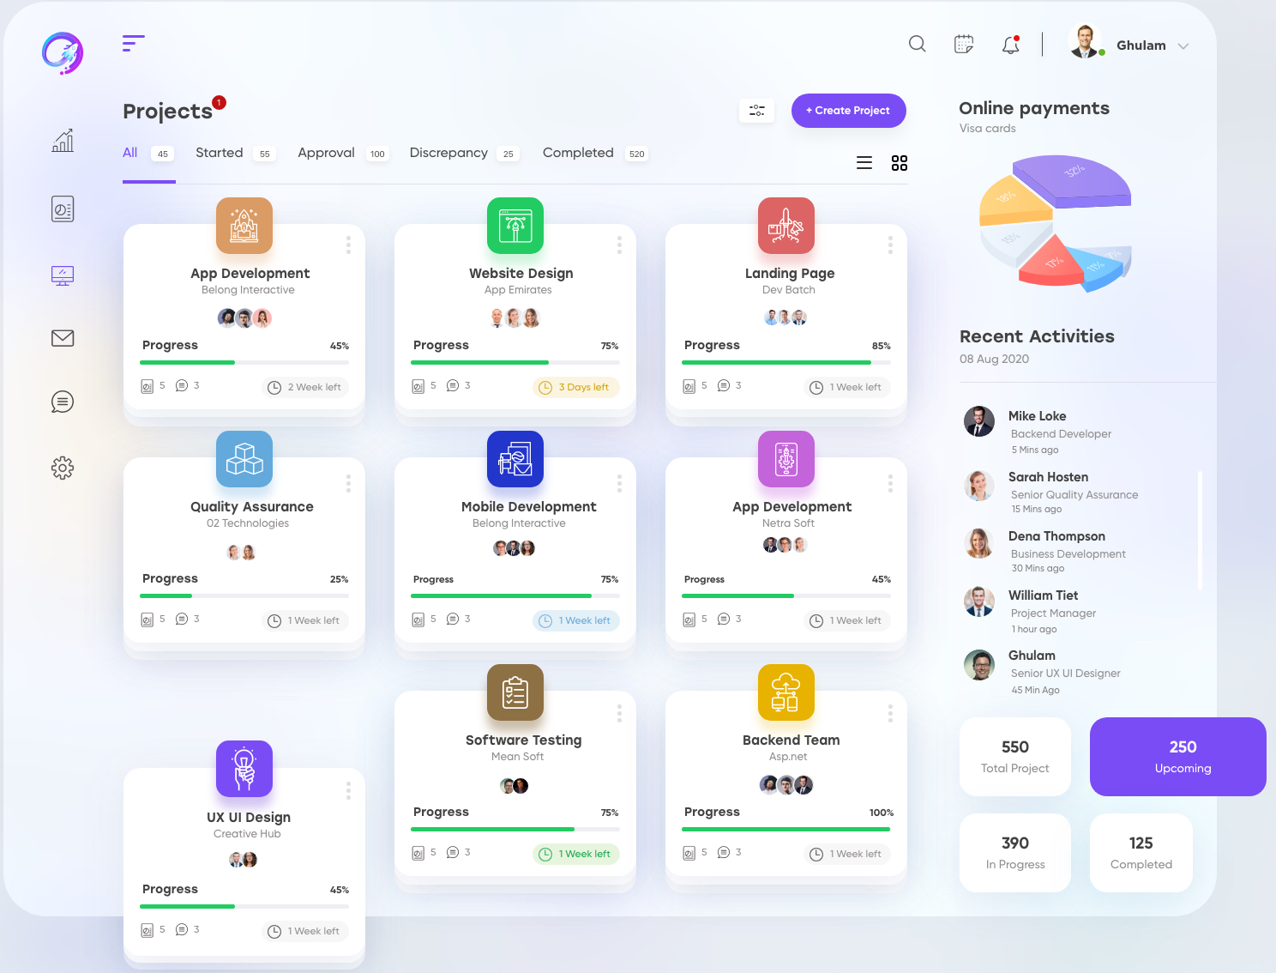
List of features
♦ Creating profile
♦ Newsfeed
♦ CV dashboard
♦ Sorting wise CG
♦ Trainer Dashboard
♦ Offer internship
♦ Can check requests

